Slide 1












Contents
GROUP 1
https://github.com/devang-1910/SOEN6841-Project
10-04-2025
Financial
Literacy
Application
SOEN 6841
STOCK SELECTION APP
Notes:
https://www.freepik.com/free-ai-image/photorealistic-timber-house-interior-with-wooden-decor-furnishings_152371631.htm

Slide 2










GROUP 1
10-04-2025
Contents
SOEN 6841
STOCK SELECTION APP
Notes:
https://www.freepik.com/free-ai-image/photorealistic-timber-house-interior-with-wooden-decor-furnishings_152371631.htm

Slide 3

Introduction
Over 50% of retail investors worldwide, including in Canada, lose money due to emotional and biased decision-making. With the growing interest in fintech, algorithmic trading, and self-directed investing, there is a clear opportunity to address this challenge.
Our solution is a Stock Selection and Financial Literacy App powered by High Quantitative Momentum (HQM) analysis, helping users make rational and informed investment decisions. While designed for global use, the app also supports Canadian-specific accounts like the TFSA and RRSP, empowering users to confidently invest through their registered plans and beyond.

Slide 4
Introduction
Over 50% of retail investors worldwide, including in Canada, lose money due to emotional and biased decision-making. With the growing interest in fintech, algorithmic trading, and self-directed investing, there is a clear opportunity to address this challenge.
Our solution is a Stock Selection and Financial Literacy App powered by High Quantitative Momentum (HQM) analysis, helping users make rational and informed investment decisions. While designed for global use, the app also supports Canadian-specific accounts like the TFSA and RRSP, empowering users to confidently invest through their registered plans and beyond.

Slide 5
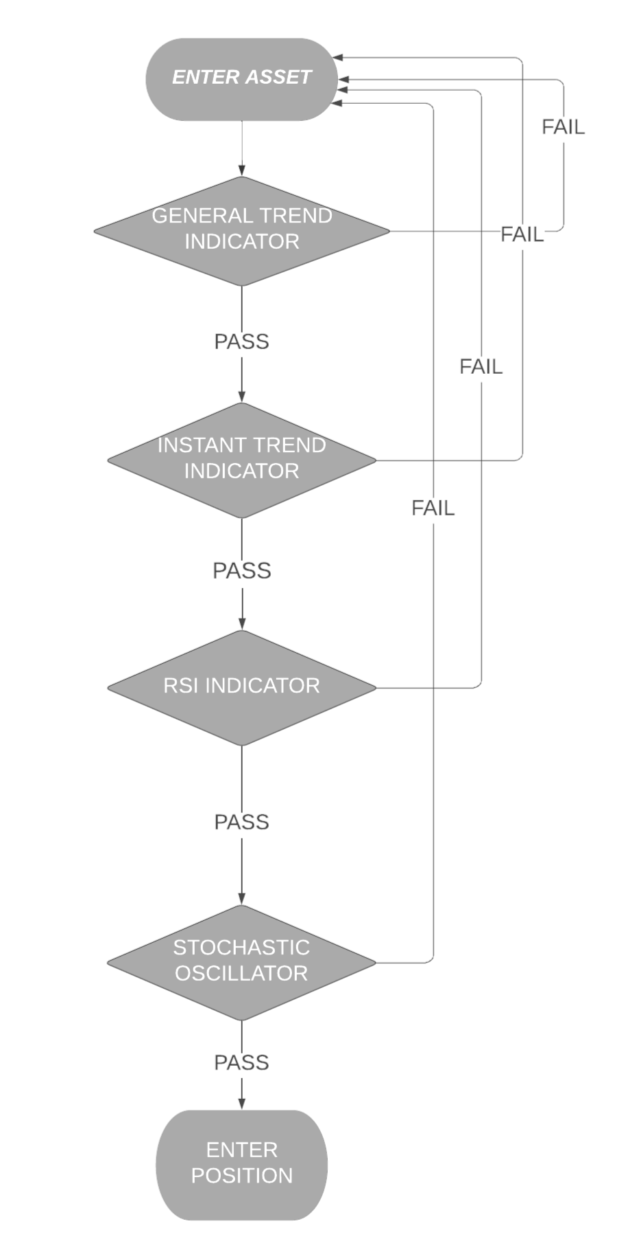
Future
Prospects
Here are the next steps
01
02
03
Get Brokerage License
Execute trades for customers based on the mentioned algorithm pattern
Adopt a brokerage model for monetization

Slide 6
Future
Prospects
Here are the next steps
01
02
03
Get Brokerage License
Execute trades for customers based on the mentioned algorithm pattern
Adopt a brokerage model for monetization

Slide 7


Market
Justification
Our market is large and rapidly growing
Target Audience
Pain Points Solved
Retail investors, financial beginners, and institutional investors (hedge/mutual fund managers).
Age: 22–60 | Markets: US, Canada, UK, India, Nigeria
Emotional bias in investing
Lack of transparency in mutual funds
Limited access to institutional-grade tools
Market Trends
Why This App?
35% rise in algorithmic investing among millennials and Gen Z.
Retail investing apps (e.g., Robinhood) show growing interest in DIY investing.
Combines real-time data with risk profiling
Offers education + execution in one seamless platform
Accessible, low-cost, and scalable

Slide 8
Market
Justification
Our market is large and rapidly growing
Target Audience
Pain Points Solved
Retail investors, financial beginners, and institutional investors (hedge/mutual fund managers).
Age: 22–60 | Markets: US, Canada, UK, India, Nigeria
Emotional bias in investing
Lack of transparency in mutual funds
Limited access to institutional-grade tools
Market Trends
Why This App?
35% rise in algorithmic investing among millennials and Gen Z.
Retail investing apps (e.g., Robinhood) show growing interest in DIY investing.
Combines real-time data with risk profiling
Offers education + execution in one seamless platform
Accessible, low-cost, and scalable

Slide 9
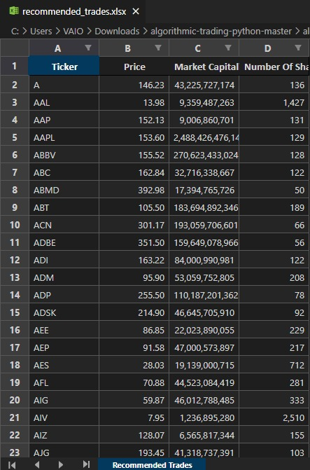
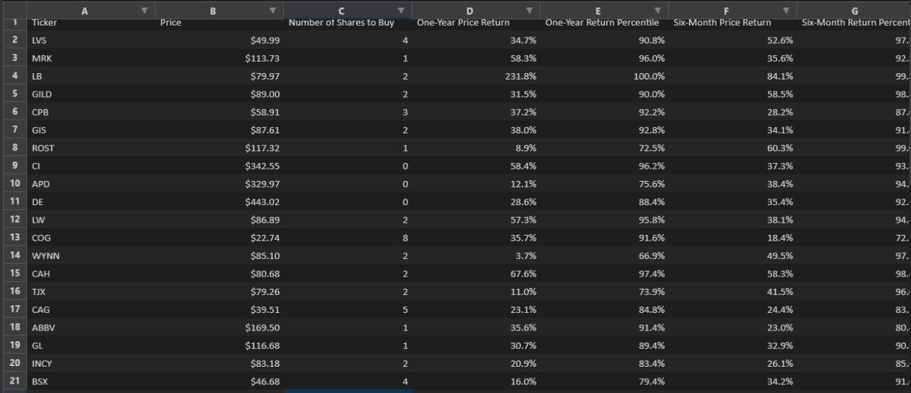
Solution
Highlights
Overview of our
business model
The application focuses on High Quantitative Momentum (HQM) Analysis.
Set parameters: choose a 6 or 12-month lookback period and the number of top stocks (e.g., 10).
Collect data: gather historical adjusted close prices.
Calculate HQM: (Current Price – Price n days ago) ÷ Price n days ago × 100.
Rank and select: order stocks by HQM score and pick top performers.
Allocate and invest: distribute capital equally or proportionally.
Rebalance: monthly or quarterly, drop laggards and add new leaders.
The app uses HQM Scores to recommend stocks and quantities, offers diversification and risk options, shortlists top picks, includes a beginner practice portal, and exports results to Excel.

Slide 10
Solution
Highlights
Overview of our
business model
The application focuses on High Quantitative Momentum (HQM) Analysis.
Set parameters: choose a 6 or 12-month lookback period and the number of top stocks (e.g., 10).
Collect data: gather historical adjusted close prices.
Calculate HQM: (Current Price – Price n days ago) ÷ Price n days ago × 100.
Rank and select: order stocks by HQM score and pick top performers.
Allocate and invest: distribute capital equally or proportionally.
Rebalance: monthly or quarterly, drop laggards and add new leaders.
The app uses HQM Scores to recommend stocks and quantities, offers diversification and risk options, shortlists top picks, includes a beginner practice portal, and exports results to Excel.

Slide 11
Project
Plan
Key milestones
SRS Finalized
Design Approved
MVP Development
Deployment & Launch
Resources Used:
GitHub, Figma
Firebase/AWS, JIRA
Agile sprints and
Kanban boards
for tracking
DEPLOYMENT &
DOCUMENTATION
TESTING
DEVELOPMENT
DESIGN
PLANNING
JAN
FEB
MAR
MAY
SEP
OCT
NOV
Financial Literacy App Project Gantt Chart (2025)

Slide 12
Project
Plan
Key milestones
SRS Finalized
Design Approved
MVP Development
Deployment & Launch
Resources Used:
GitHub, Figma
Firebase/AWS, JIRA
Agile sprints and
Kanban boards
for tracking
DEPLOYMENT &
DOCUMENTATION
TESTING
DEVELOPMENT
DESIGN
PLANNING
JAN
FEB
MAR
MAY
SEP
OCT
NOV
Financial Literacy App Project Gantt Chart (2025)

Slide 13
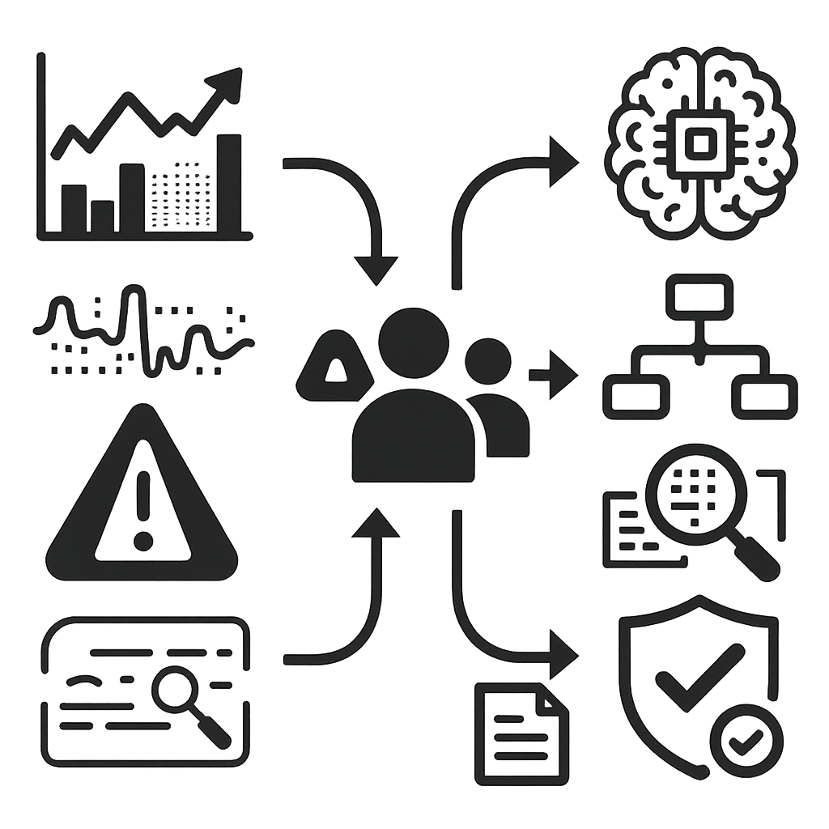
Risk
Management
Mitigating Risks, Maximising Potential
Key Risks
Mitigation
Market volatility
Data quality
Overfitting models
Outsourcing of Risk not an option without proof of concept
Continuous learning model
Multiple Scenario-based testing
Regular data audits
Compliance with all standards
Proof of concept in multiple use cases for Insurance purposes

Slide 14
Risk
Management
Mitigating Risks, Maximising Potential
Key Risks
Mitigation
Market volatility
Data quality
Overfitting models
Outsourcing of Risk not an option without proof of concept
Continuous learning model
Multiple Scenario-based testing
Regular data audits
Compliance with all standards
Proof of concept in multiple use cases for Insurance purposes

Slide 15
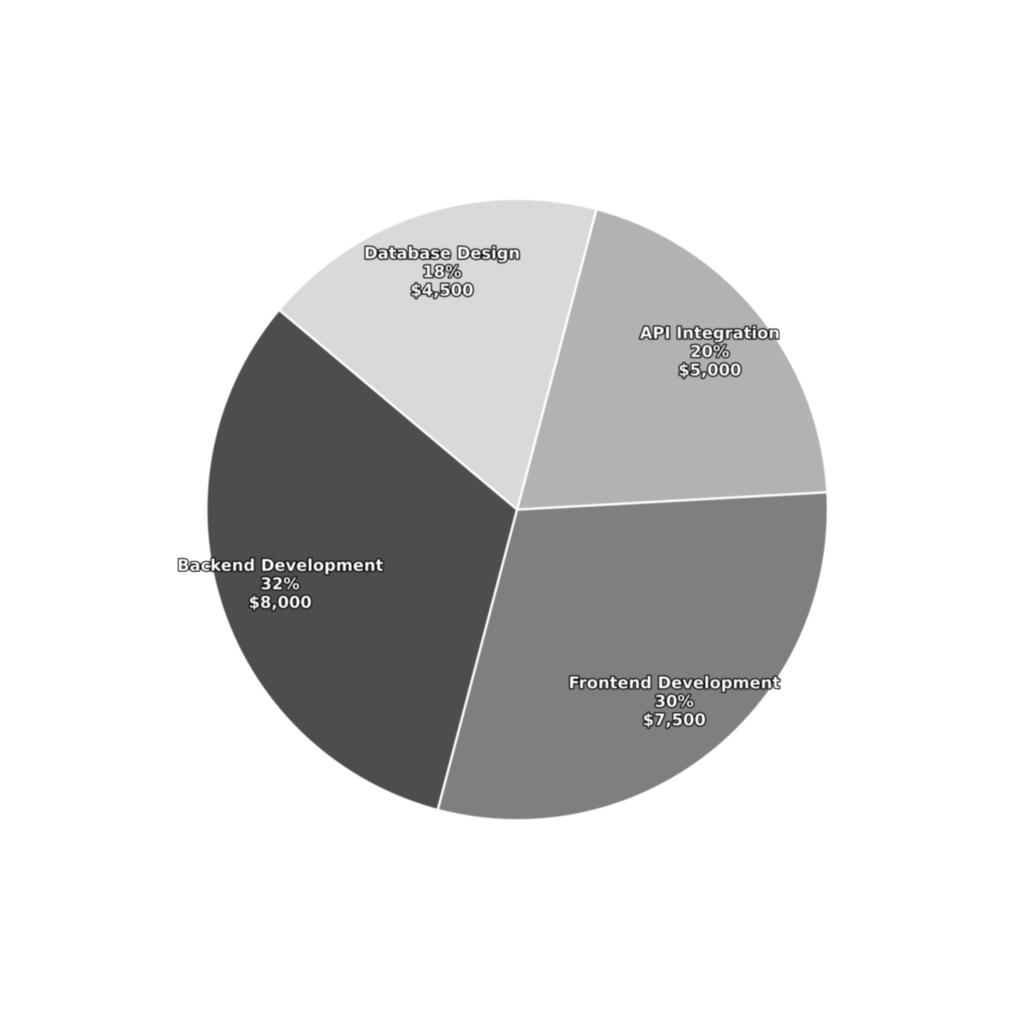
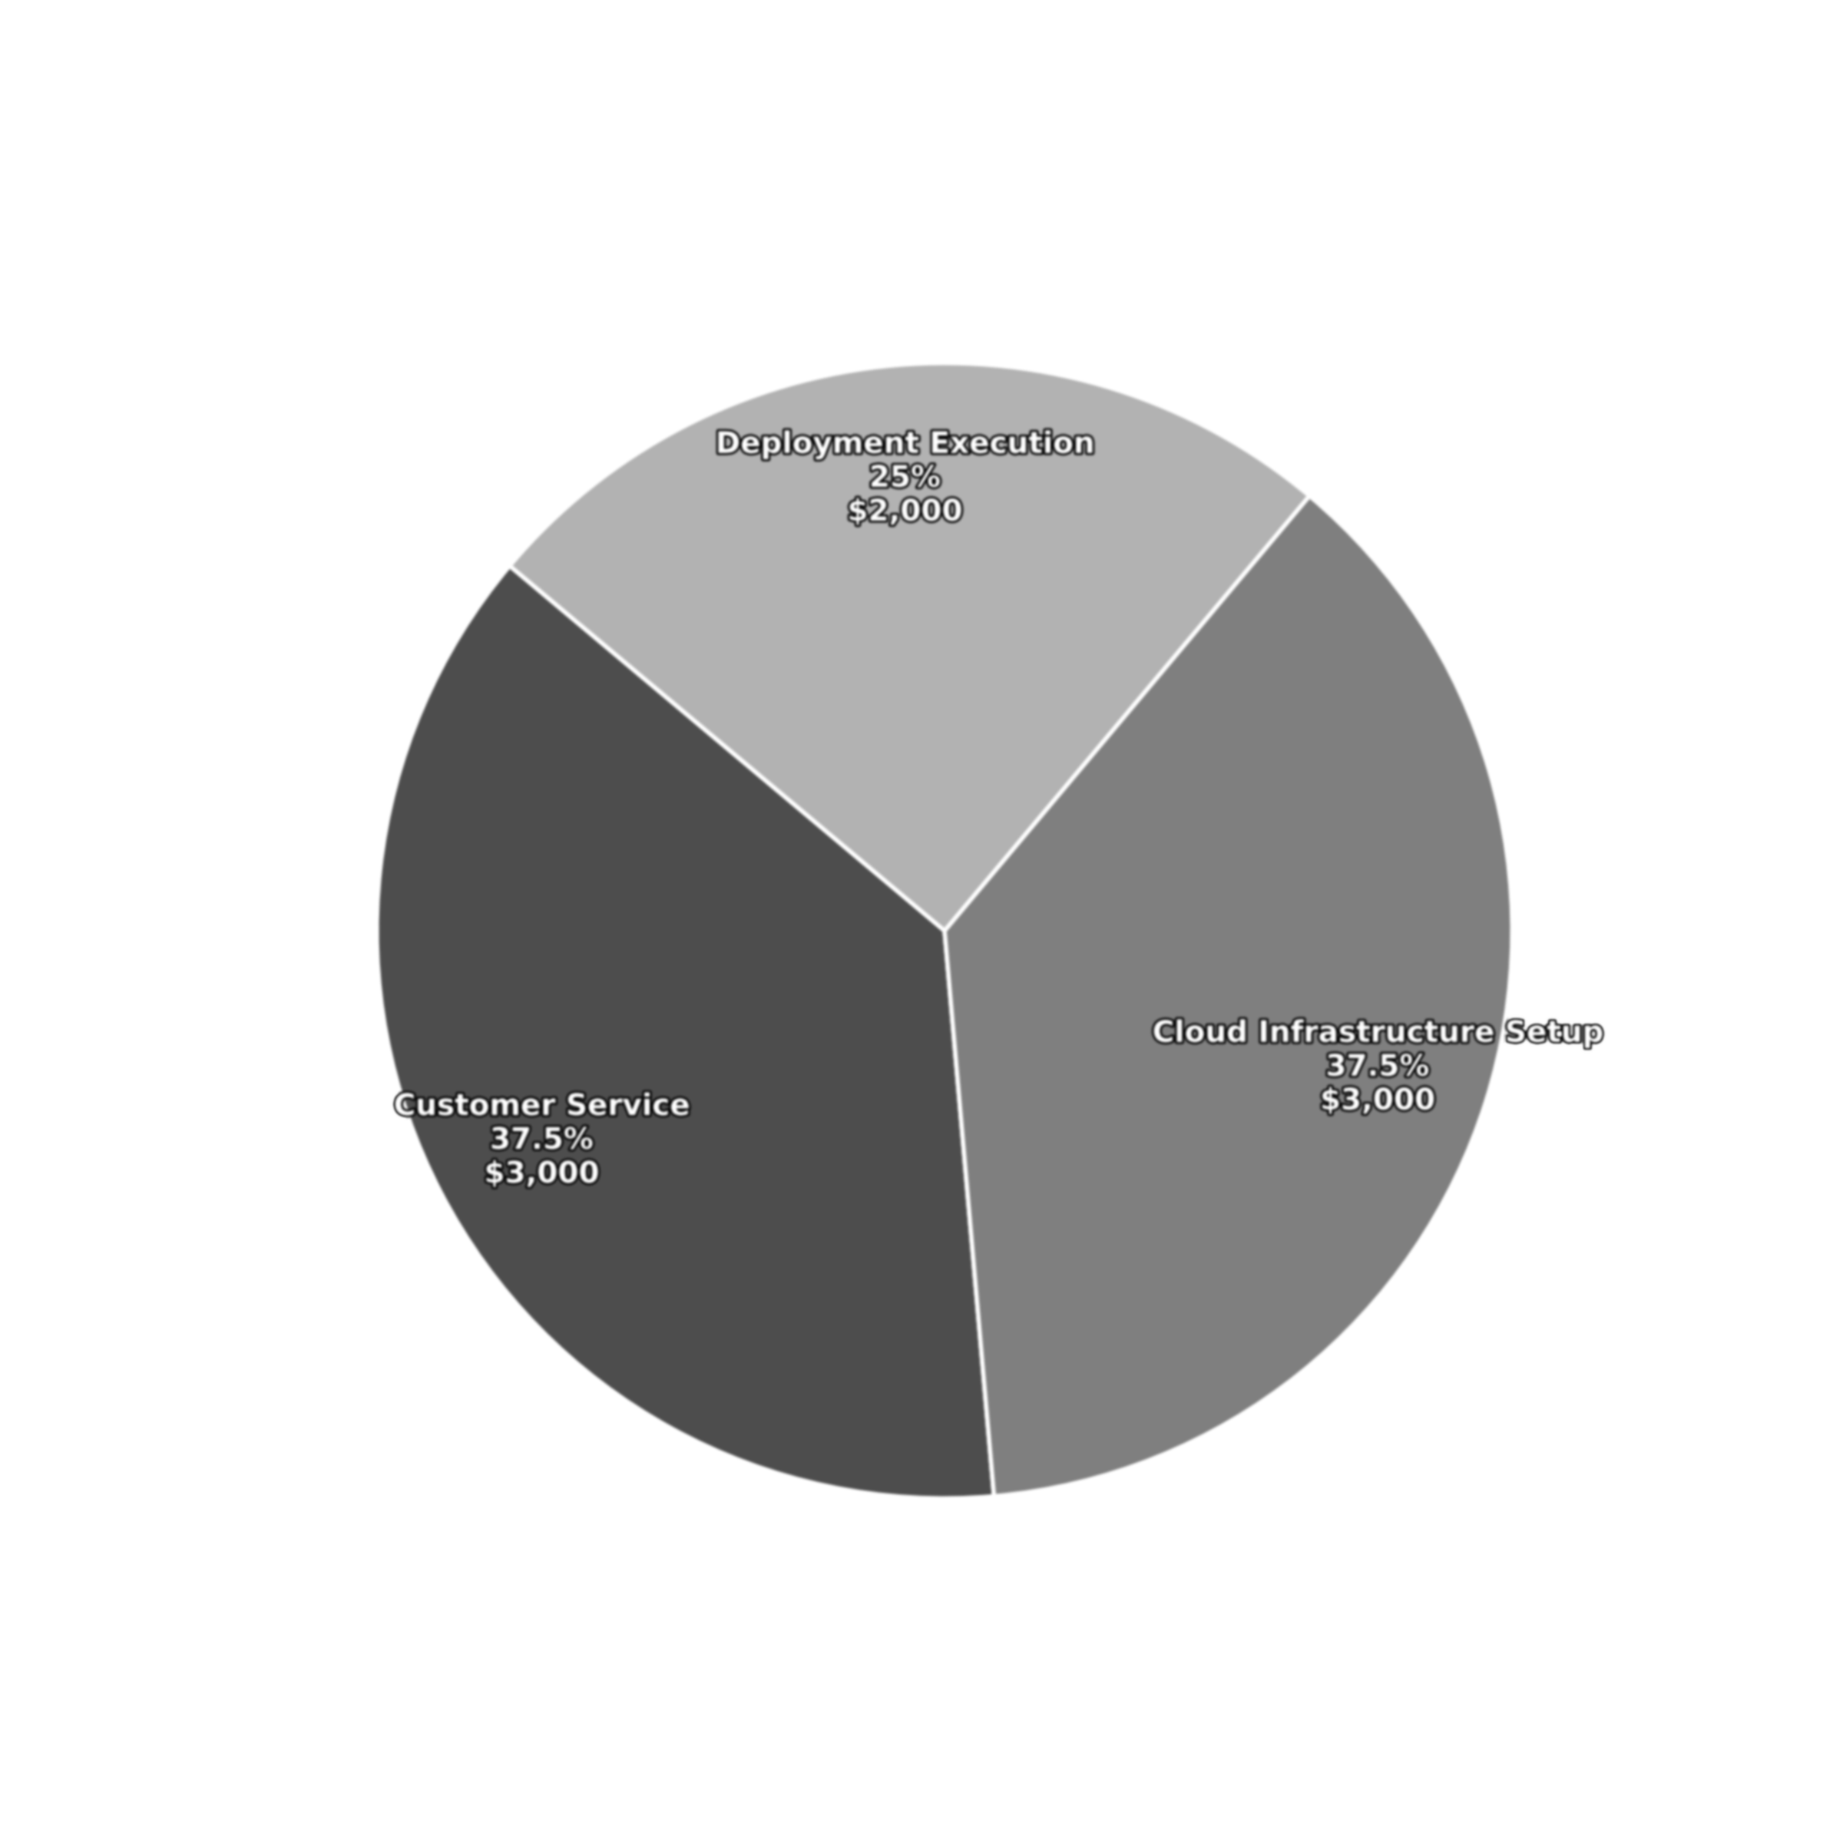
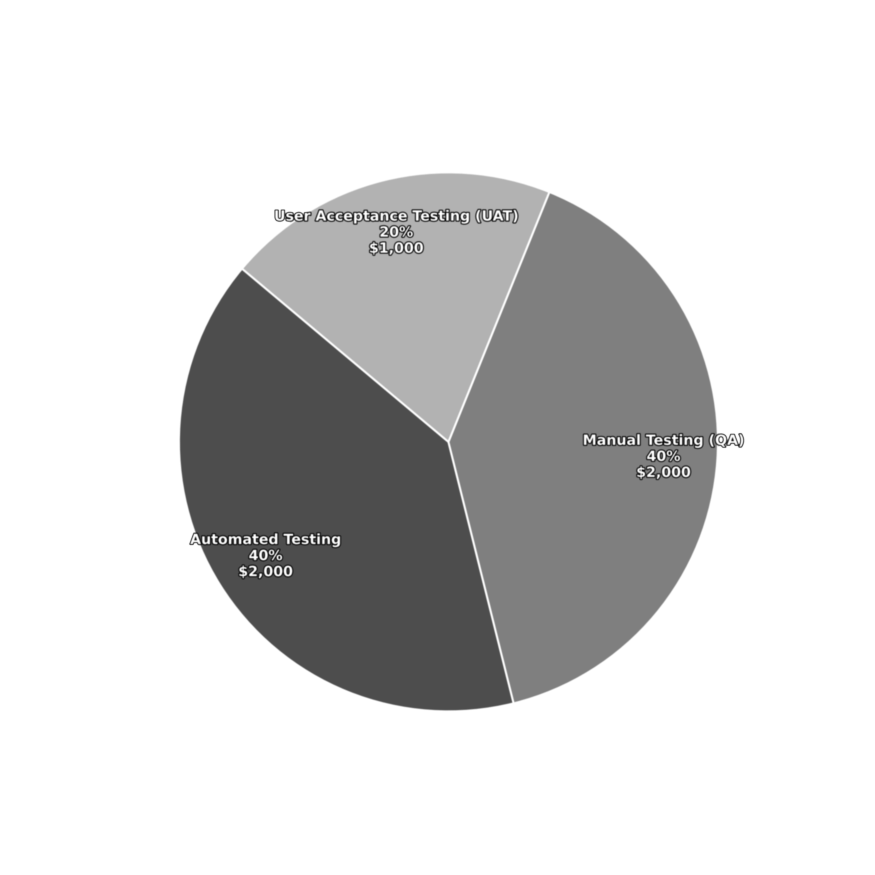
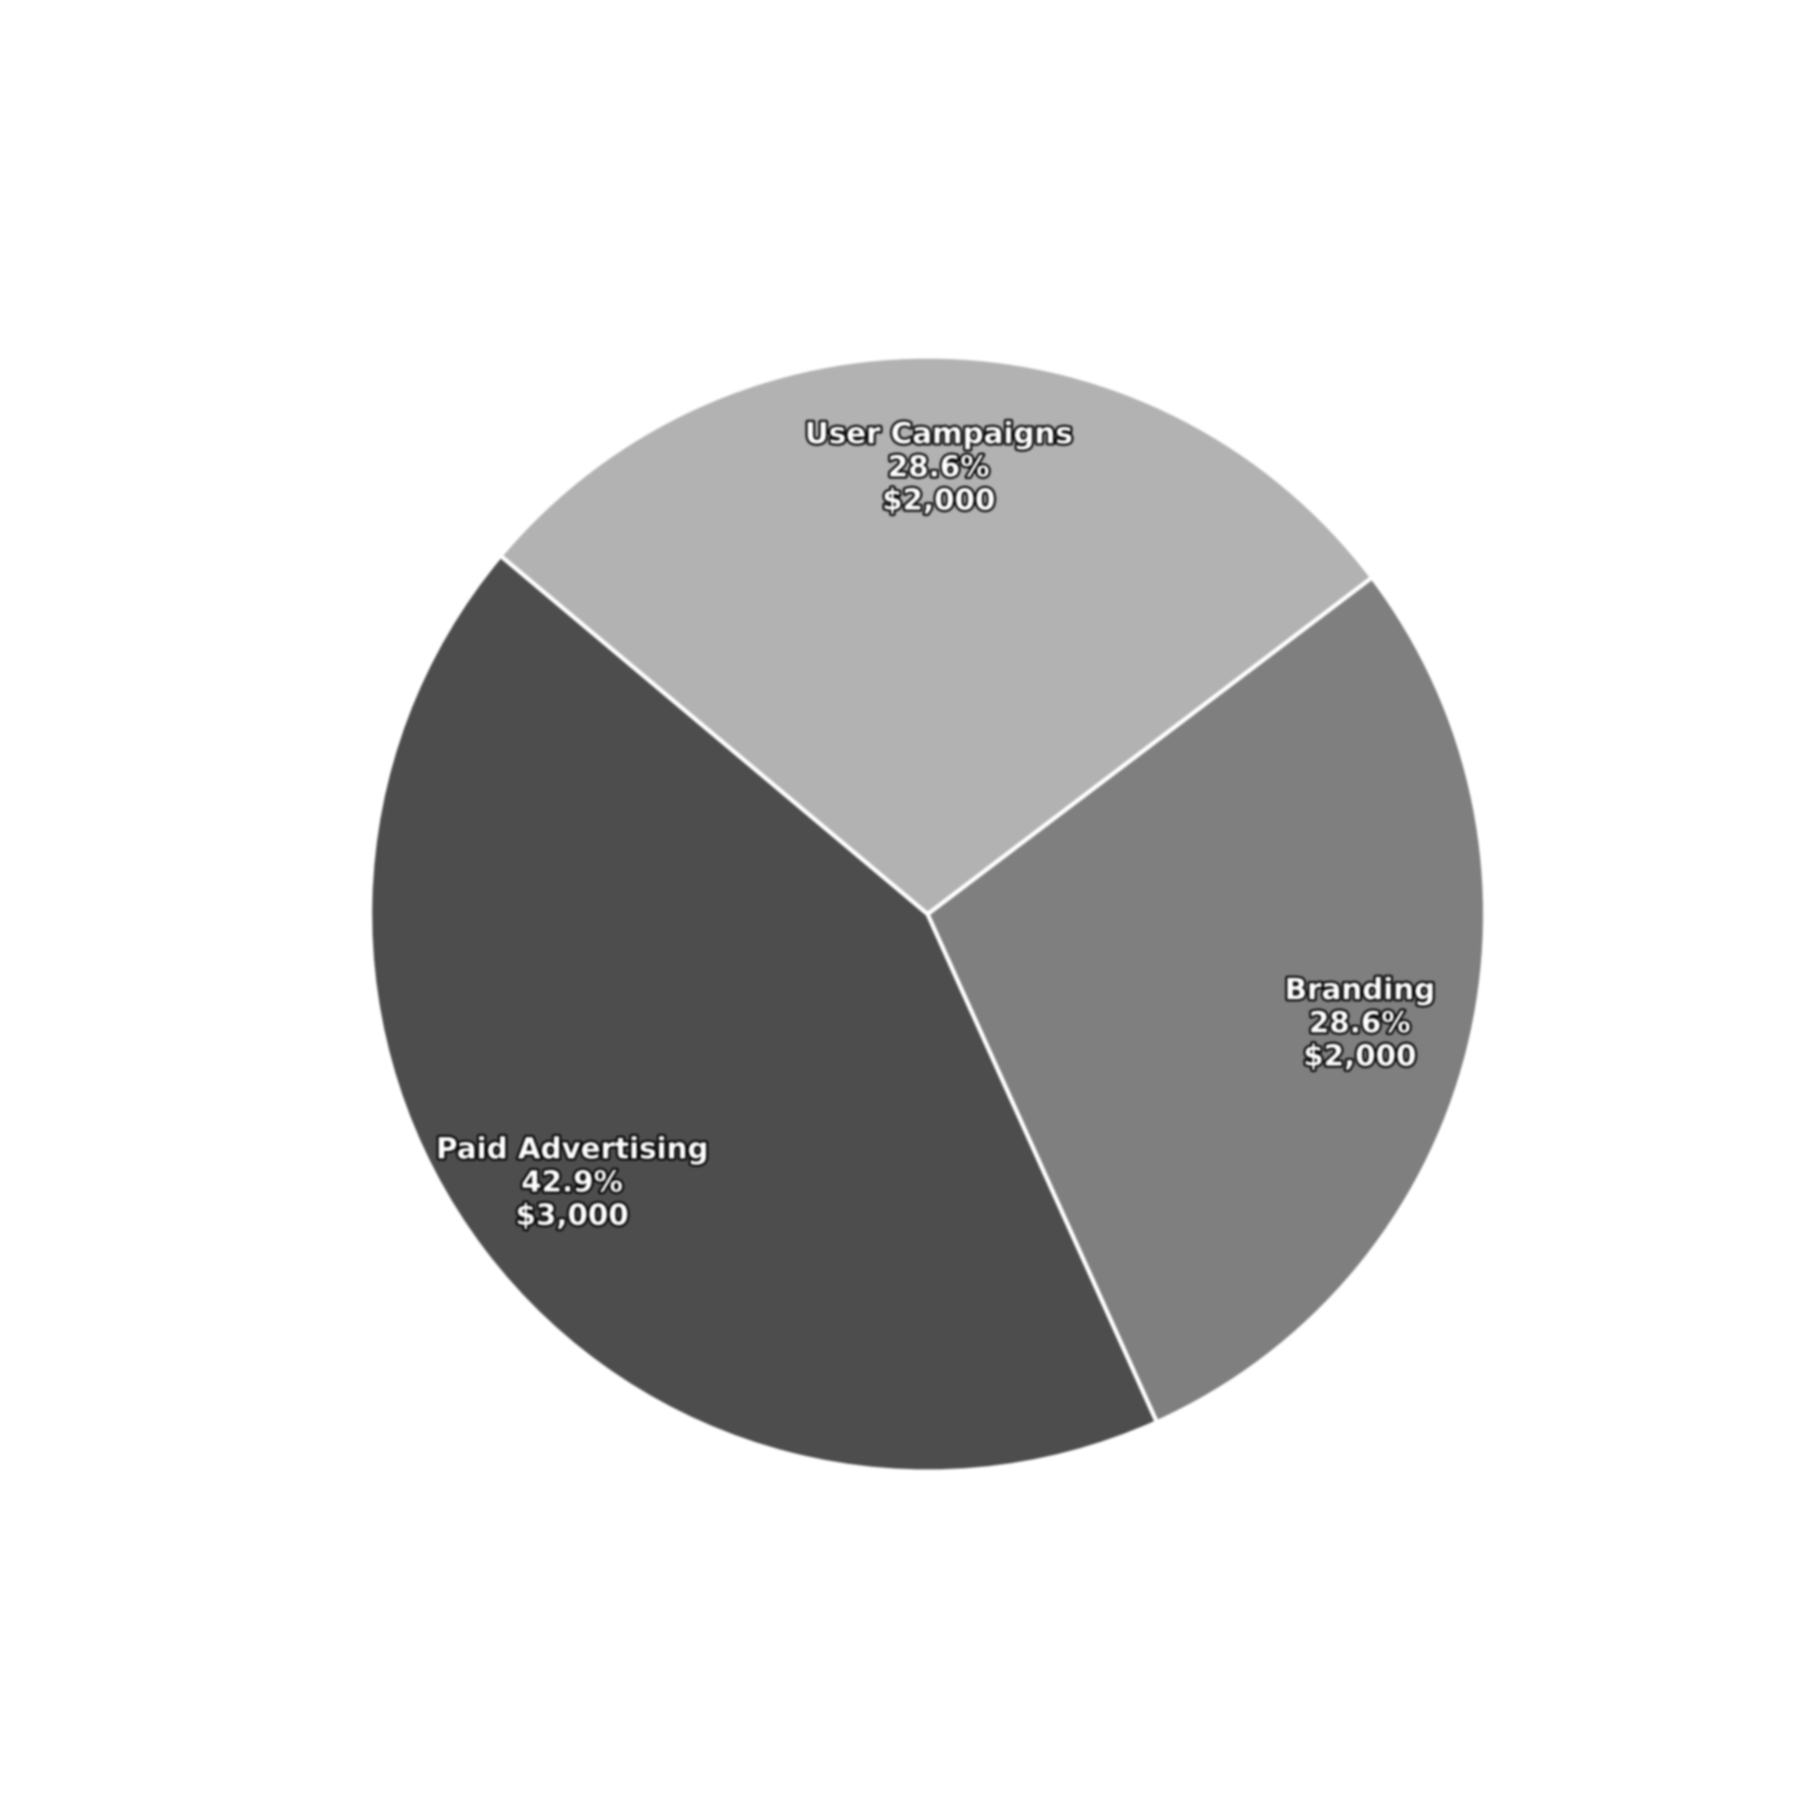
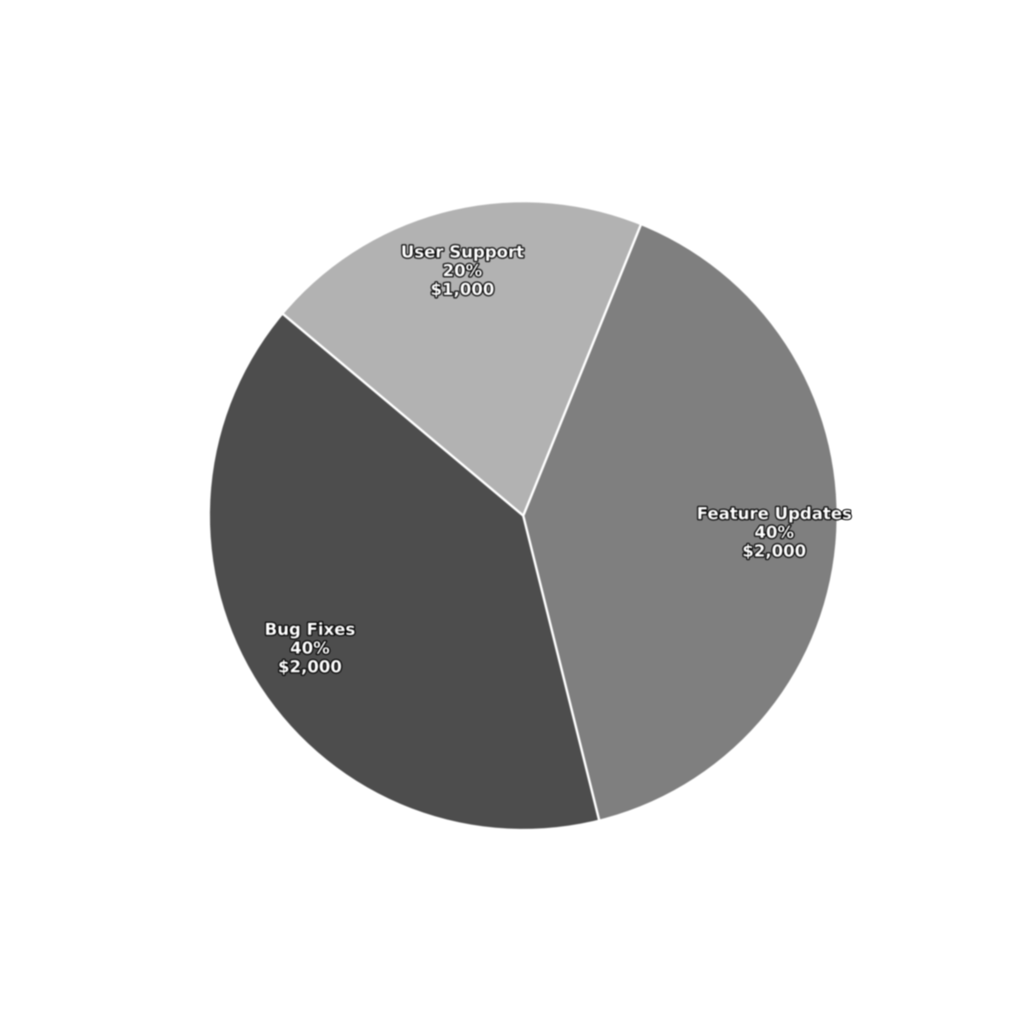
Financials
Budget Overview

Slide 16
Financials
Budget Overview

Slide 17
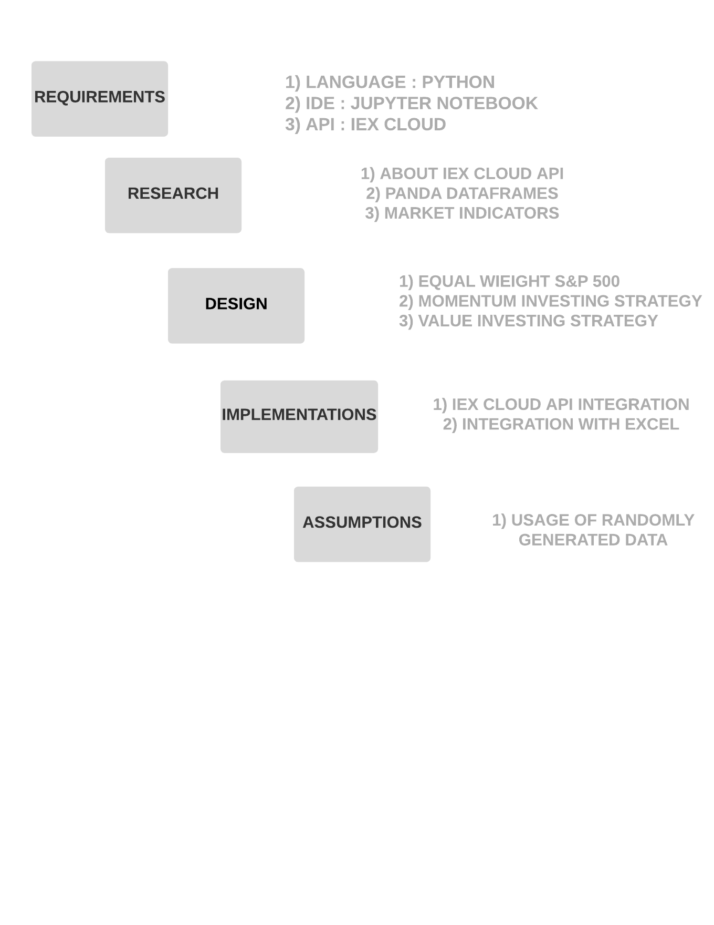
Feasibility
Study
Feasibility
And
Viability
Operational
Automates investing
Easy to use, minimal training
Phased rollout with support
Technical
Stack: Python, React, Flutter, Docker
APIs: IEX, Alpha Vantage
Cloud: AWS/Firebase, OAuth 2.0, 2FA
Scalable & secure
Economic
Cost: ~$30K total
ROI: 200–250% (3 yrs)
Saves ~$2K/user/year

Slide 18
Feasibility
Study
Feasibility
And
Viability
Operational
Automates investing
Easy to use, minimal training
Phased rollout with support
Technical
Stack: Python, React, Flutter, Docker
APIs: IEX, Alpha Vantage
Cloud: AWS/Firebase, OAuth 2.0, 2FA
Scalable & secure
Economic
Cost: ~$30K total
ROI: 200–250% (3 yrs)
Saves ~$2K/user/year

Slide 19

Our Team
Success is a team effort!
Joshua
Devshree
Devang
Angad

Slide 20
Our Team
Success is a team effort!
Joshua
Devshree
Devang
Angad

